Slide 1


RECEIPT FREE
MENTORS
Mr. RAVI GANTA
Dr. GARY BOETTICHER
GROUP MEMBERS KENA
LOVIN
MANEESH
NIDHI
Maneesh, Nidhi, Kena, Lovin , Slide# 1/11

Slide 2
AGENDA
1) INTRODUCTION
2) MARKET ANALYSIS
3) DESIGN
4) GOOGLE CLOUD VISION OCR
5) IMPLEMENTATION
6) DEMO
7) CONCLUSION& FUTURE ADAVANCEMENTS
Mane
Maneesh,Slide# 2/11
Notes:
2 min

Slide 3
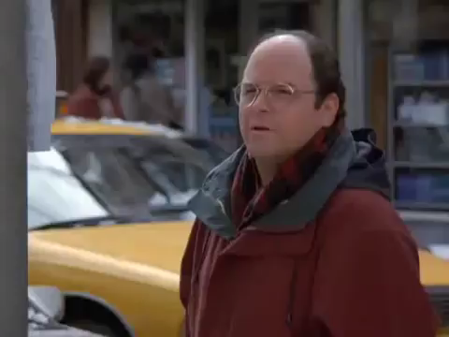
IS THIS YOUR WALLET ?
Mane
Maneesh,Slide# 3/11

Slide 4
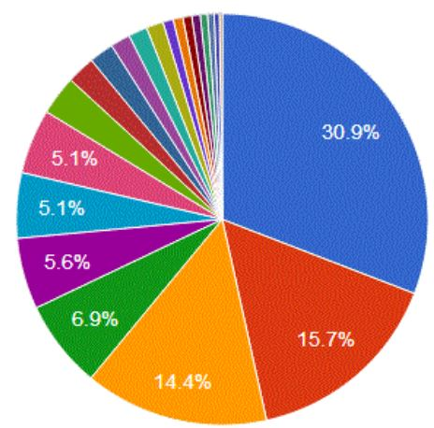
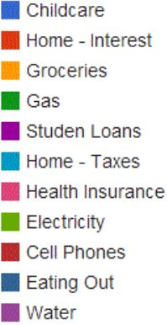
THE PROBLEM: HOW ACCOUNTABILITY HELPS IN FINANCIAL MANAGEMENT
INTRODUCTION
Maneesh, Slide# 4/11
Notes:
2 min

Slide 5
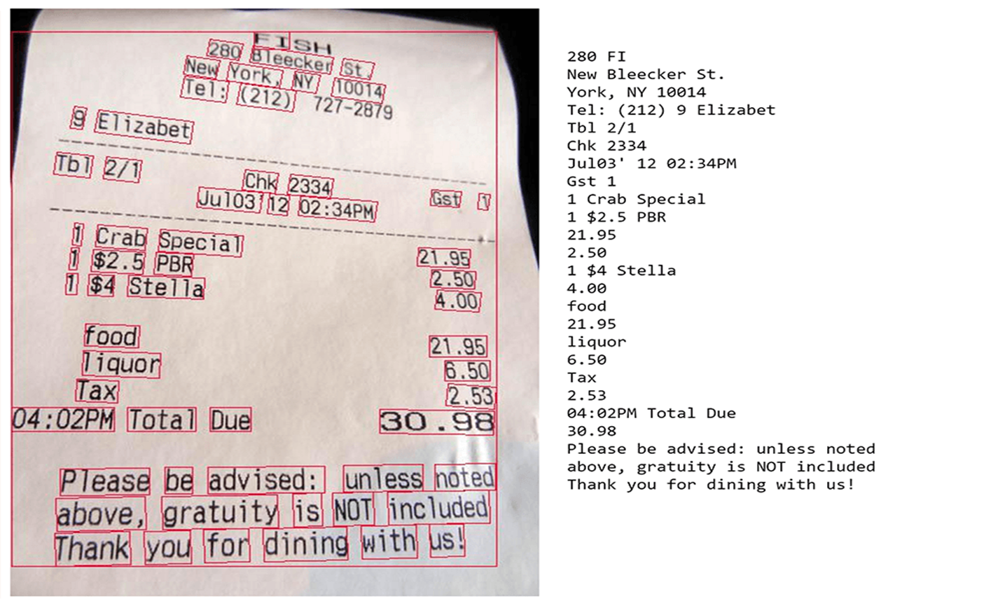
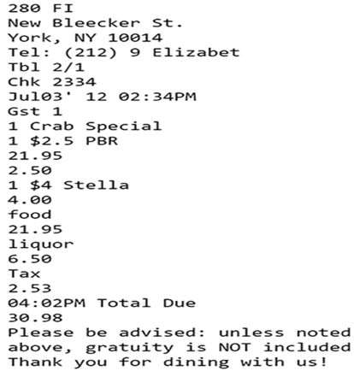
MARKET ANALYSIS
HOW RECEIPT FREE IS DIFFERENT FROM OTHER APPS?
ACCURATE LOCATION DETAILED PURCHASE
CONFIDENTIAL EASY ACCESS.
Notes:
2 min

Slide 6
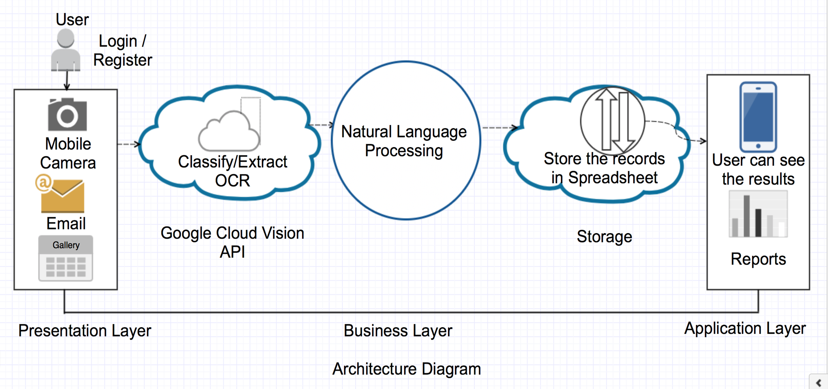
DESIGN
ARCHITECTURAL DIAGRAM
Nidhi ,Slide# 6/11
Notes:
2 or 3 min
Advantages of OCR. The advantages of OCR are numerous, but namely it increases the efficiency and effectiveness of office work. The ability to instantly search through content is immensely useful, especially in an office setting that has to deal with high volume scanning or high document inflow.

Slide 7
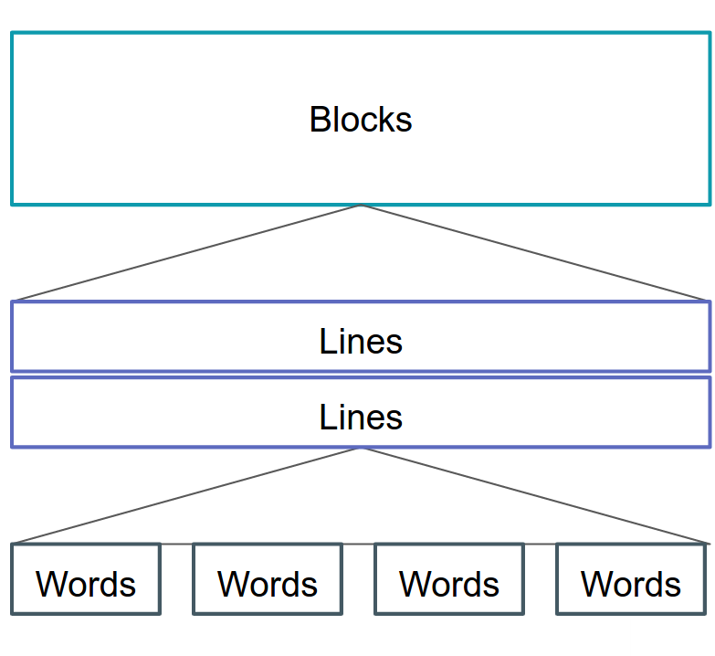
GOOGLE CLOUD VISION OCR
What is it ? Why we need it?
ADVANTAGES
Text Detection Single String Accurate.
Kena, Slide# 7/11

Slide 8
IMPLEMENTATION
POTENTIAL PROBLEMS WHILE PERFORMING OCR
LIVE CAMERA & FUNCTIONING
FIREBASE
GOOGLE NATURAL LANGUAGE PROCESSING (NLP)
SPEECH TO TEXT
STORAGE AND DATA VISUALIZATION
Manessh,Kena,Lovin,Nidhi, , Slide# 8/11

Slide 9

DEMO
Lovin Slide# 9/11

Slide 10
CONCLUSION
Receipt Free serves as both Expense Cloud and Advisor in
terms of Accountability in Financial Management.
FUTURE ADVANCEMENTS
1) IMPROVEMENT IN TEXT EXTRACTION ALGORITHM
2) EXTENSION OF NLP INTO MACHINE LEARNING
3) PORTABALITY INTO IOS PLATFORM
4) EXTRACTION OF TEXT FROM SCRAMBLED,
HANDWRITTEN RECEIPTS.
Maneesh,Lovin , Slide #10/11

Slide 11

THANK YOU
Maneesh,Kena,Lovin,Nidhi, , Slide# 11/11

